Slide 1

OPEN HASHING
(Separate chaining)

Slide 2
DEFINATION
A collision resolution method in hash tables where keys that map to the same index are stored in linked lists attached to cells of the hash table. In open hashing, collisions are resolved by storing keys outside the main hash table structure, allowing each slot in the hash table to be the head of a linked list where records associated with that slot are placed. This method is effective for handling collisions and allows for efficient insertion and retrieval of elements in the hash table

Slide 3
STRATEGY
0
700
50
73
76
1
85
92
2
H(x)= X mod 7
So the range of this function will be from 0 → 6
101
3
Keys= 50, 700, 76, 85, 92, 73, 101
4
50 mod 7= 1
700 mod 7= 0
76 mod 7= 6
85 mod 7= 1
92 mod 7=1
73 mod 7 = 3
101 mod 7= 3
5
6

Slide 4
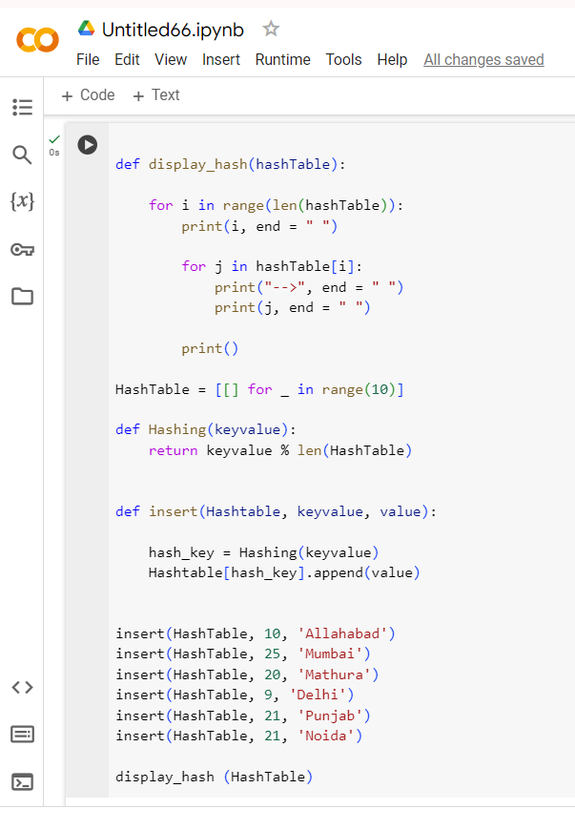
Algorthim
(

Slide 5
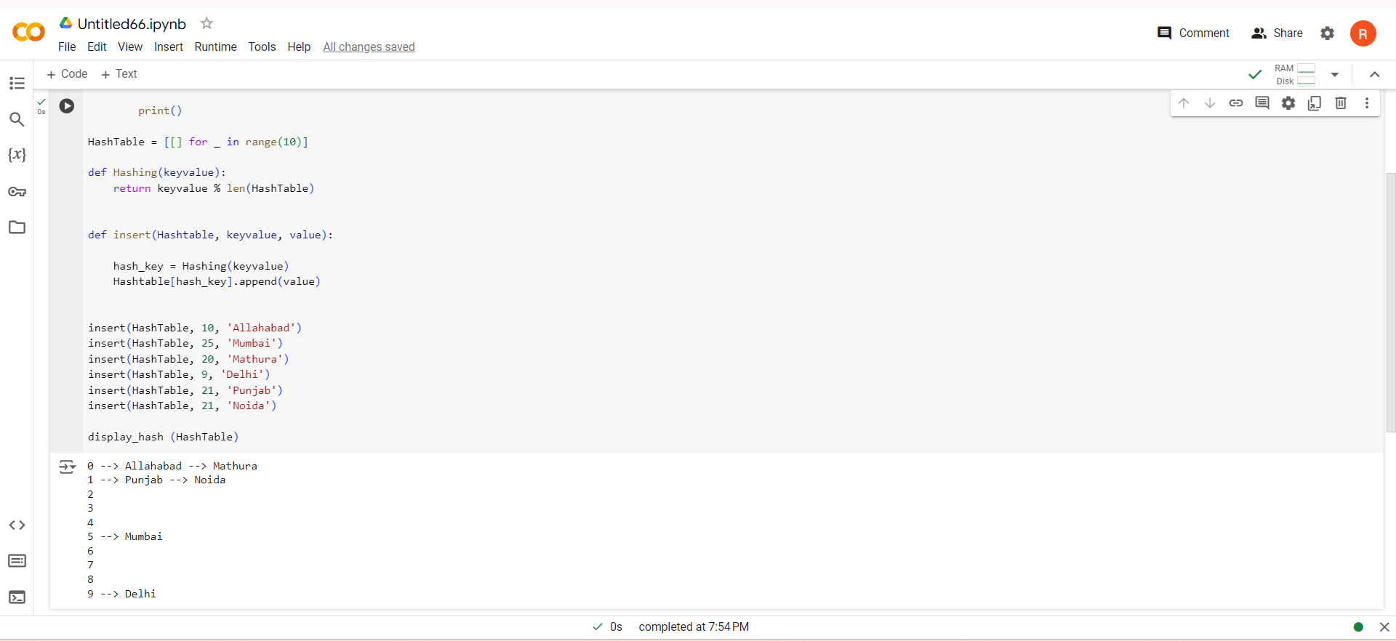
Implementation
(

Slide 6
Analysis
Search Time Complexity: O(1) on average, of good hash function and minimal collisions.
Insert Time Complexity: O(1) on average, of minimal collisions and constant time hash key.
Space Complexity: O(n + m), where n is the number of key-value pairs inserted and m is the size of the hash table.
(

